Slide 1
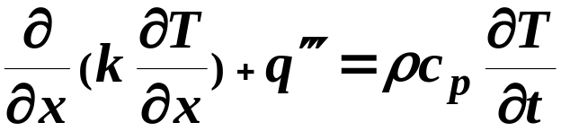
CHAPTER 7
NON-LINEAR CONDUCTION PROBLEMS
7.1 Introduction
Non-linearity is due to:
• Temperature dependent properties
• Radiation effect
• Free convection at boundary
• Phase change
7.2 Sources of Non-linearity
7.2.1 Non-linear Differential Equations
 • Temperature dependent properties
(7.1)

Slide 2



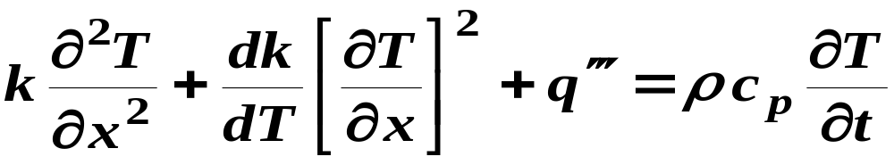
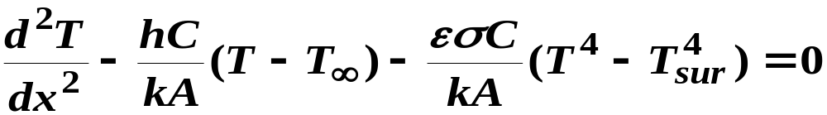
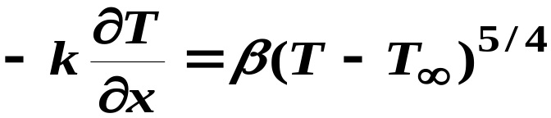
    Rewrite 7.1
(7.2)
• Fins with convection and radiation
(7.3)
7.2.2 Non-linear Boundary Conditions
(1) Free convection
(7.4)

Slide 3
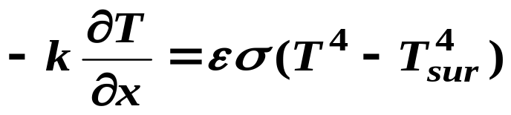
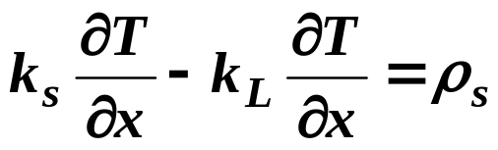
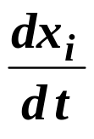
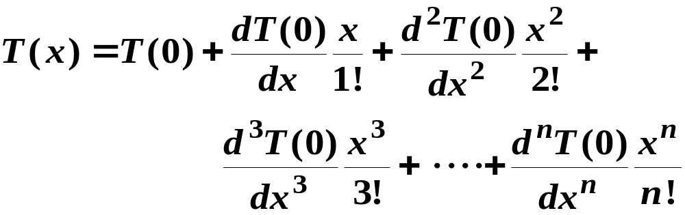
(2) Radiation
(7.5)
(3) Phase change interface
L
(7.6)
7.3 Taylor Series Method
(7.7)

Slide 4
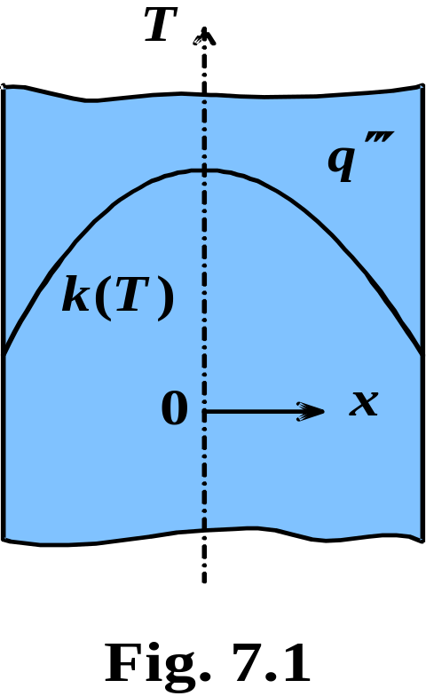

Example 7.1: Slab with Variable Thermal Conductivity
Solution
(1) Observations
• Non-linearity is due to variable k
• Symmetry
• Expansion about mid-plane
(2) Origin and Coordinates: Fig. 7.1
(3) Formulation
(i) Assumptions

Slide 5
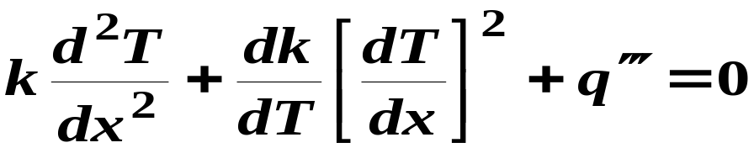
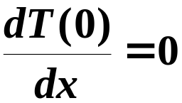
(1) Steady state
(2) Symmetry
(3) Uniform energy generation
(ii) Governing Equation
(a)
NOTE: The heat equation is not solved in this method.
(iii) Boundary Conditions
(1)
T (0) = T_{o}
(2)

Slide 6
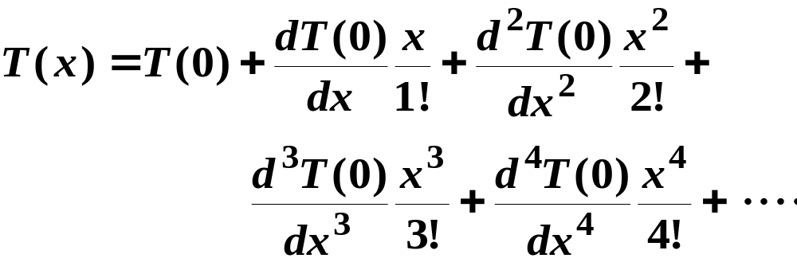
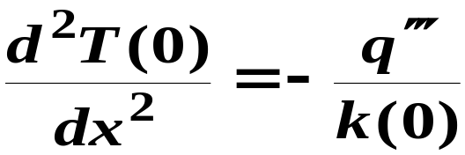
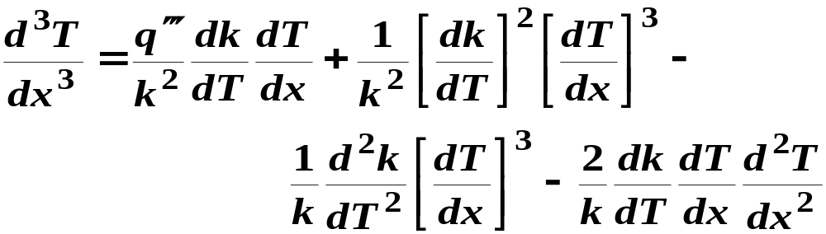
(4) Solution. Use Taylor series expansion, eq. (7.7)
(b)
Second derivative: Apply the heat equation (a) at
(c)
Third derivative: Differentiate (a)
(d)

Slide 7
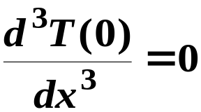
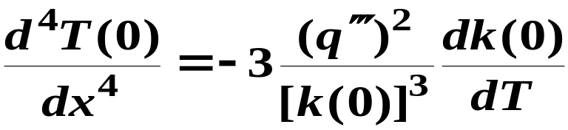
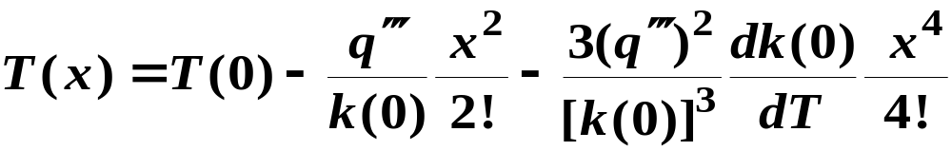

Evaluating (d) at x = 0 and using BC (2)
(e)
Fourth derivative: Differentiate (d), set x = 0, use BC (2) and (c)
(f)
Substitute into (b)
(g)
where
(h)

Slide 8

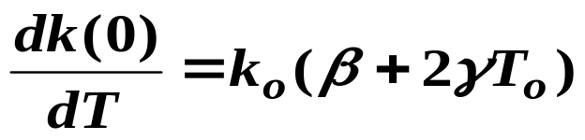
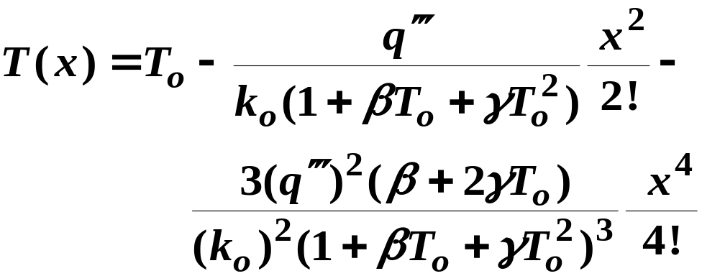
BC (1) and (h)
(i)
and
(j)
Substituting (i) and (j) into (g)
(k)
(5) Checking
Dimensional check

Slide 9
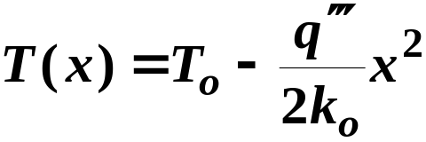
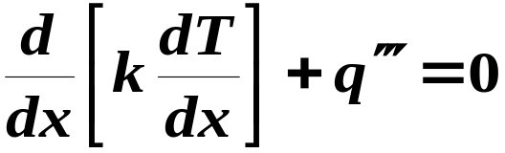
Limiting check:
(i) Constant k: set β = γ = 0 in (k)
(l)
This is the exact solution for constant
(ii) Symmetry: Even powers of x
(6) Comments
(i) Role of L
(ii) Accuracy of solution
(iii) Exact solution to eq. (7.1)
(m)

Slide 10
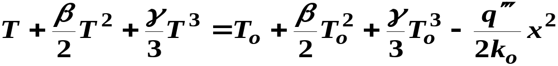
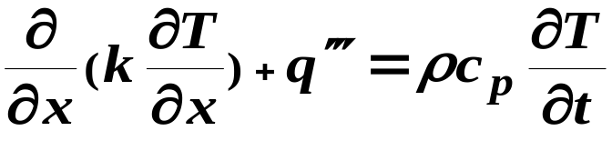
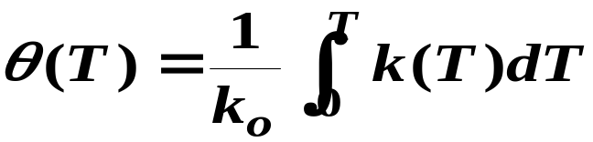

Substitute (h) into (m), separate variables, integrate and apply the
two BC
(n)
7.4 Kirchhoff Transformation
7.4.1 Transformation of Differential Equation
Applies to variable k. Differential equation:
(7.1)
Define
(7.8)
(7.8) gives a relationship between
and T.

Slide 11
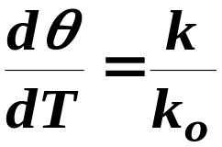


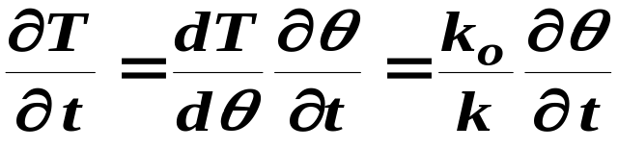
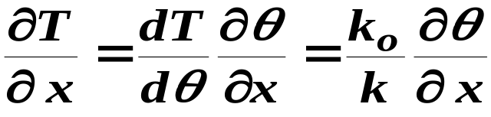
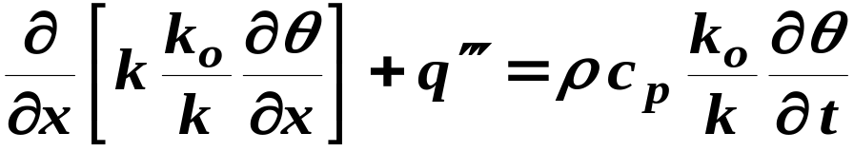
Differentiate (7.8)
(a)
Transformation of
and
(b)
(c)
(b) and (c) into (7.1)

Slide 12
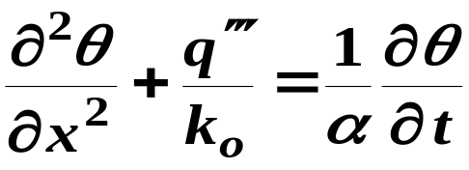
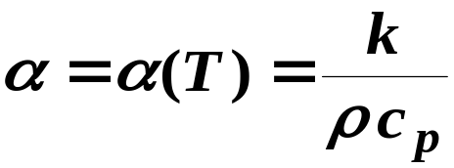
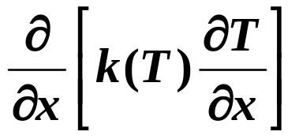
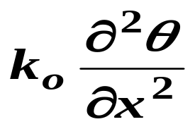
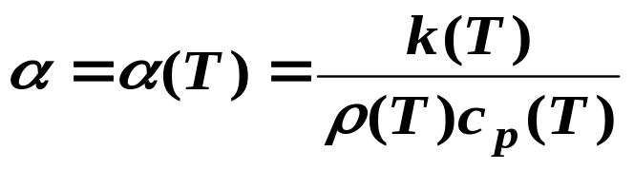
(7.9)
NOTE:
•
(non-linear) →
(linear)
•
: (7.9) is still non-linear
• Steady state stationary problems: eq. (7.9) becomes linear
• Approximation: α = constant, eq. (7.9) becomes linear

Slide 13



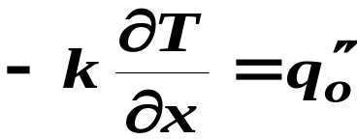
7.4.2 Transformation of Boundary Conditions
(1) Specified Temperature
(7.10)
Eq. (7.8) gives
(a)
Eq. (7.10) into (a)
(7.11)
Thus, specified T → specified θ = θ_{o}
(2) Specified Heat Flux
(7.12)

Slide 14
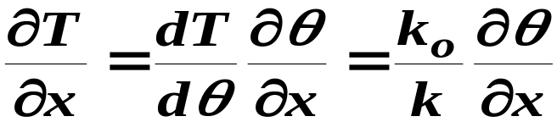
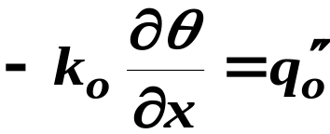
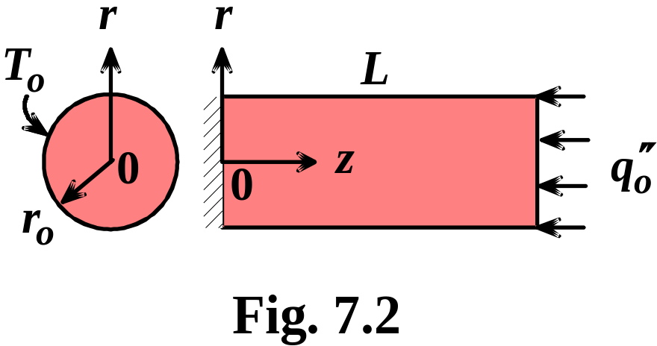

However
(b)
(b) into eq. (7.12)
(7.13)
Example 7.2:
2-D conduction in a cylinder with variable k(T)
Determine: Steady state temperature distribution

Slide 15
Solution
(1) Observations
 • Non-linearity is due to variable k
 • BC: Specified temperature and specified heat flux
 • Kirchhoff transformation is applicable
(2) Origin and Coordinates
(3) Formulation
(i) Assumptions.
(1) Steady state
(2) Two-dimensional conduction
(3) Axisymmetric temperature distribution.

Slide 16
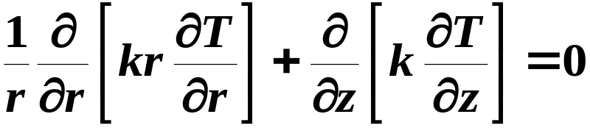
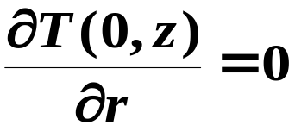

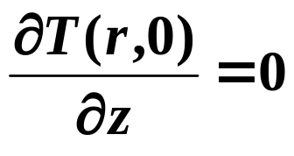
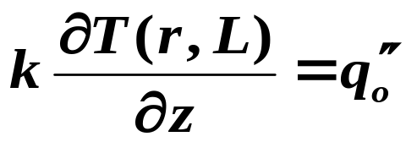
(ii) Governing Equations. Eq. (1.11) for variable k
(a)
(iii) Boundary Conditions
(1)
(2)
(3)
(4)

Slide 17
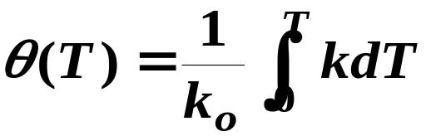

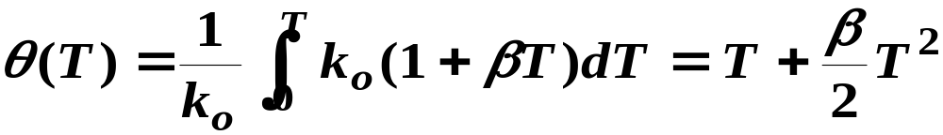
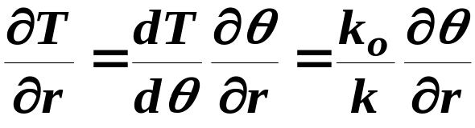
(4) Solution. Use Kirchhoff transformation
(b)
(c)
(c) into (b)
(d)
Determine θ :
Transform the governing equation and boundary
conditions
(c)

Slide 18

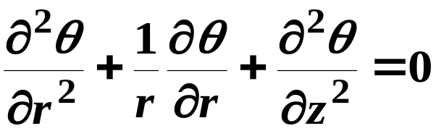
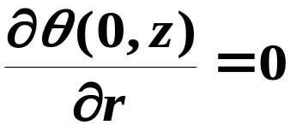

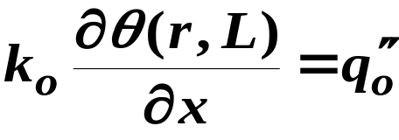
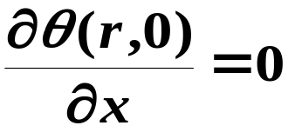
(e)
(e) into (a)
(f)
Transformation of BC
(1)
(2)
(3)
(4)

Slide 19
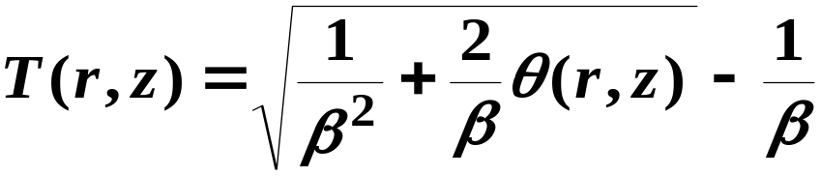
NOTE:
• DE and BC are linear
• Eq. (f) is solved by separation of variables
• Solution gives θ(r,z)
• T(r,z) is obtained from (d)
7.5 Boltzmann Transformation
• Based on similarity method
• Limited to semi-infinite domains
• Restricted initial and boundary conditions

Slide 20
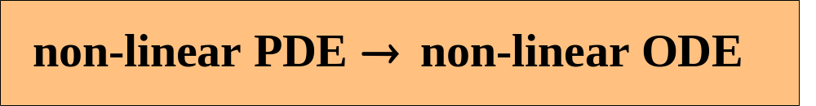

• Combines two variables (similarity variable): For k = k(T)
• Result:
Example 7.3:
Transient Conduction in a Semi-
infinite Region, Variable Conductivity
Initial temperature = T_{i}
Surface temperature = T_{o}
Determine: T(x,t)

Slide 21
(1) Observations
• Semi-infinite, uniform initial temperature: Similarity solution
is possible
• Non-linearity is due to k = k(T)
(2) Origin and Coordinates
(3) Formulation
(i) Assumptions
(1) One-dimensional transient conduction
(2) initial temperature is uniform.

Slide 22


(ii) Governing Equations
(a)
(iii) Boundary and Initial Conditions
(1) T(0 , t) = T_{o}
(2) T(∞ , t) = T_{i}
(3) T(x , 0) = T_{i}
(4) Solution. Introduced η (x,t)
(b)

Slide 23

(a) becomes
(7.14)
Transformed BC and IC:
(1) T(0) = T_{o}
(2) T(∞) = T_{i}
(3) T(∞) = T_{i}
NOTE:
• PDE → ODE
• Eq. (7.14) is second order. Needs two B.C.
• Transformed problem has two B.C.

Slide 24
• Eq. (7.14) is non-linear: k = k (T) , ρ = ρ (T) and c _{p} = c _{p} (T)
• Solution for constant ρ and c_{p} is obtained using successive
approximation
(5) Comments. Note restriction on solution:
 • Semi-infinite region
 • Uniform initial temperature
 • Constant surface temperature
 • Constant ρ and c_{p}
 • Solution by successive approximation
7.6 Combining Boltzmann and Kirchhoff
Transformations
Re do Example 7.3. Introduce the Kirchhoff transformation

Slide 25






(7.8)
Applying eq. (7.8) to eq. (7.14)
(7.15)
(a)
NOTE: Eq. (7.15) is non-linear because
B.C.
(1)
(2)

Slide 26








Assume: constant
eq. (7.15) becomes linear. Solution becomes
(b)
BC give A and B
(c)
Convert (c) from
to
Use eq. (7.8) . For specified
this equation gives
in terms of
Example:
(d)
(d) into eq. (7.8)

Slide 27









The constants
and
become
7.7 Exact Solutions
• Semi-infinite fin
• Convection and radiation at surface
• Ambient and fluid at
(7.16)
,
(a)

Slide 28





B.C.
(1)
(2)
Introduce the transformation
(b)
Differentiating (b)
(c)
Solving (b) for dx
(d)

Slide 29




(d) into (c)
(e)
Using (e) to eliminate
in eq. (7.16)
(7.17)
Separating variables and integrating
(f)
where C is constant of integration.

Slide 30







Solving (f) for
and using (b)
(g)
If
then
use negative sign
Determine C, apply (g) at
(h)
Substituting (h) into (g) and solving for C gives
(i)

Slide 31









To determine
(7.18)
plus sign is for
NOTE
• Exact solution is for
• No solution for
• For
use same method. Need
At
(j)

Slide 32


Substituting (j) into (7.16) gives
This equation is solved for
by a trial and error procedure.

